Slide 1
Monday, September 19, 2016
Write In Your Agenda:
Write In Your Monitoring Log:
CW:
Sea Floor Spreading reading and activity.
HW:
Finish Picturing Life on Pangaea (if not done already)
Response to Warm-Up:
What theory , based on evidence from ocean floor exploration, led to the theory of plate tectonics.
You will need:
Pencil
Hand in Monitoring Log
Get new Monitoring Log

Slide 2
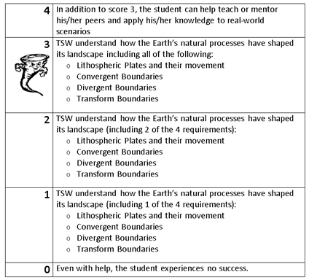
Learning Goal and Scale
TSW understand how the Earth’s natural processes have shaped its landscape (including Lithospheric Plates and their movement, Convergent, Divergent, and Transform boundary landforms).

Slide 3
https://www.youtube.com/watch?v=KCSJNBMOjJs

